Slide 1
Tutorial 7: Counting Sort and Hashing
Fangyuan ZHANG
Department of Systems Engineering and Engineering Management
Chinese University of Hong Kong
Tutorial 7

Slide 2
Outline
Counting Sort
Chaining
Open Addressing
Robin Hood Hashing
Tutorial 7

Slide 3
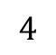
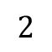
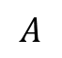
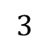

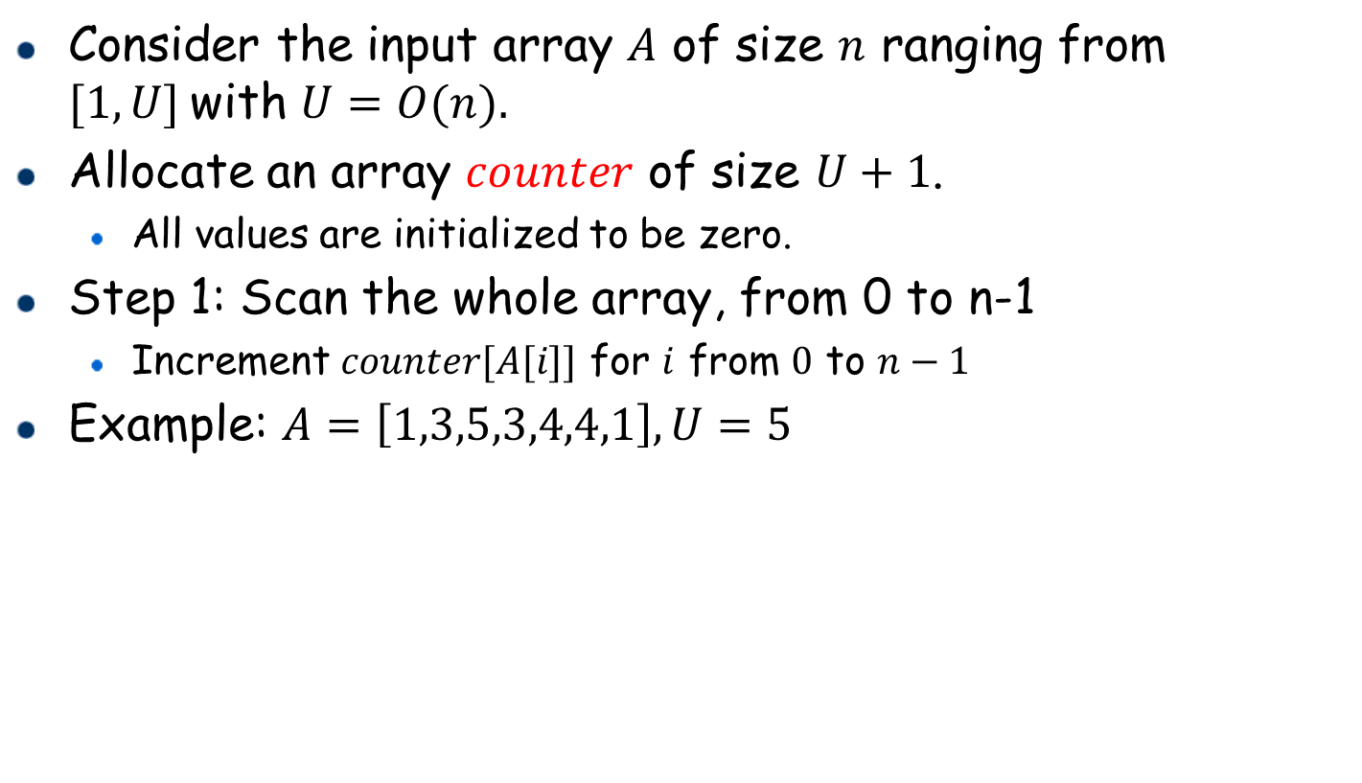
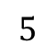
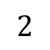


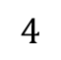
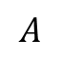

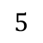
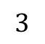
Counting Sort
Consider the input array $A$ of size $n$ ranging from $[1,U]$with $U=O(n).$
Allocate an array $counter$ of size $U+1$.
All values are initialized to be zero.
Step 1: Scan the whole array, from 0 to n-1
Increment $counter[A[i]]$ for $i$ from $0$ to $n−1$
Example: $A=\left[1,3,5,3,4,4,1\right], U=5$
$$A$$
1 | 3 | 5 | 3 | 4 | 4 | 1
$$A$$
1 | 3 | 5 | 3 | 4 | 4 | 1
$$counter$$
0 | 0 | 0 | 0 | 0
$$counter$$
0 | 0 | 2 | 2 | 1
1
2
$$1$$
$$2$$
$$3$$
$$4$$
$$5$$
$$1$$
$$2$$
$$3$$
$$4$$
$$5$$

Slide 4
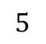
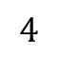

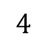
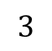
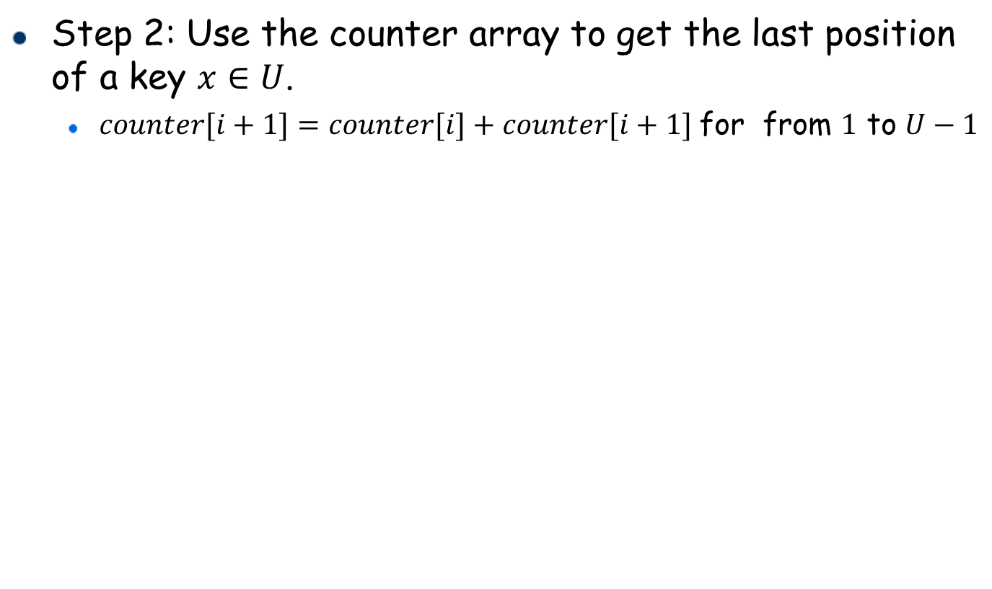
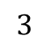
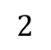
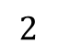

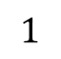

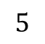
Counting Sort
Step 2: Use the counter array to get the last position of a key $x∈U$.
$counter[i+1]=counter[i]+counter[i+1]$for from $1$ to $U−1$
$$counter$$
0 | 0 | 2 | 2 | 1
$$counter$$
0 | 2 | 4 | 6 | 7
2
2
$$1$$
$$2$$
$$3$$
$$4$$
$$5$$
$$1$$
$$2$$
$$3$$
$$4$$
$$5$$

Slide 5
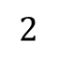
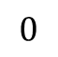
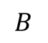
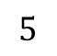
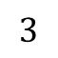

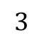

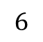

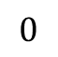
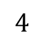
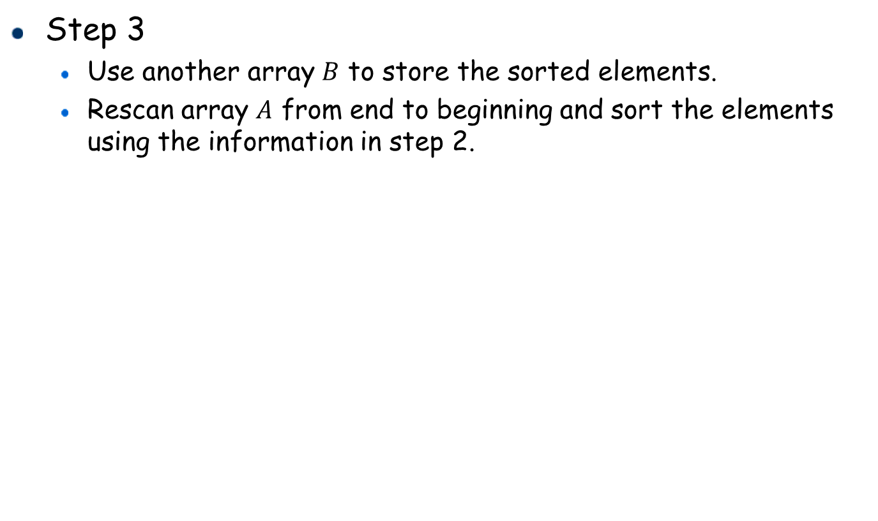
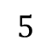
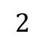
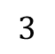
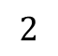
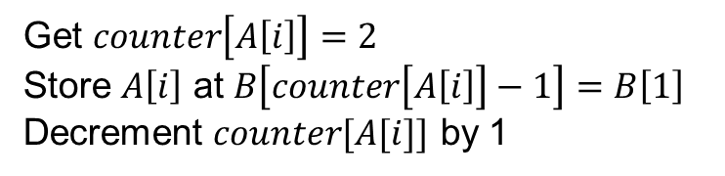
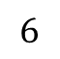
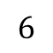
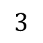
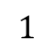
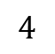
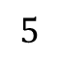
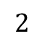
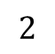
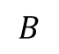

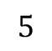

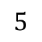
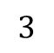
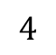

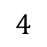



Counting Sort
Step 3
Use another array $B$ to store the sorted elements.
Rescan array $A$ from end to beginning and sort the elements using the information in step 2.
i=6
Get $counter\left[A\left[i\right]\right]=2$
Store $A\left[i\right]$ at $B\left[counter\left[A\left[i\right]\right]−1\right]=B\left[1\right]$
Decrement $counter[A[i]]$ by 1
$$A$$
1 | 3 | 5 | 3 | 4 | 4 | 1
$$0$$
$$1$$
$$2$$
$$3$$
$$4$$
$$5$$
$$6$$
$$counter$$
0 | 2 | 4 | 6 | 7
2
$$1$$
$$2$$
$$3$$
$$4$$
$$5$$
$$B$$
 | 1
$$B$$
$$0$$
$$1$$
$$2$$
$$3$$
$$4$$
$$5$$
$$6$$
$$0$$
$$1$$
$$2$$
$$3$$
$$4$$
$$5$$
$$6$$
$$counter$$
0 | 2 | 4 | 6 | 7
1
$$1$$
$$2$$
$$3$$
$$4$$
$$5$$

Slide 6










































































Counting Sort
i=5
Get $counter\left[A\left[i\right]\right]=6$
Store $A\left[i\right]$ at $B\left[counter\left[A\left[i\right]\right]−1\right]=B\left[5\right]$
Decrement $counter[A[i]]$ by 1
$$A$$
1 | 3 | 5 | 3 | 4 | 4 | 1
$$0$$
$$1$$
$$2$$
$$3$$
$$4$$
$$5$$
$$6$$
$$B$$
 | 1 |  |  |  | 4
$$counter$$
0 | 2 | 4 | 6 | 7
1
$$0$$
$$1$$
$$2$$
$$3$$
$$4$$
$$5$$
$$6$$
$$1$$
$$2$$
$$3$$
$$4$$
$$5$$
$$counter$$
0 | 2 | 4 | 5 | 7
$$B$$
 | 1
1
$$0$$
$$1$$
$$2$$
$$3$$
$$4$$
$$5$$
$$6$$
$$1$$
$$2$$
$$3$$
$$4$$
$$5$$
i=4
Get $counter\left[A\left[i\right]\right]=5$
Store $A\left[i\right]$ at $B\left[counter\left[A\left[i\right]\right]−1\right]=B\left[4\right]$
Decrement $counter[A[i]]$ by 1
$$A$$
1 | 3 | 5 | 3 | 4 | 4 | 1
$$0$$
$$1$$
$$2$$
$$3$$
$$4$$
$$5$$
$$6$$
$$counter$$
0 | 2 | 4 | 5 | 7
$$B$$
 | 1 |  |  | 4 | 4
1
$$1$$
$$2$$
$$3$$
$$4$$
$$5$$
$$0$$
$$1$$
$$2$$
$$3$$
$$4$$
$$5$$
$$6$$
$$B$$
 | 1 |  |  |  | 4
$$counter$$
0 | 2 | 4 | 4 | 7
1
$$0$$
$$1$$
$$2$$
$$3$$
$$4$$
$$5$$
$$6$$
$$1$$
$$2$$
$$3$$
$$4$$
$$5$$

Slide 7










































































Counting Sort
i=3
Get $counter\left[A\left[i\right]\right]=4$
Store $A\left[i\right]$ at $B\left[counter\left[A\left[i\right]\right]−1\right]=B\left[3\right]$
Decrement $counter[A[i]]$ by 1
$$A$$
1 | 3 | 5 | 3 | 4 | 4 | 1
$$0$$
$$1$$
$$2$$
$$3$$
$$4$$
$$5$$
$$6$$
$$counter$$
0 | 2 | 4 | 4 | 7
$$B$$
 | 1 |  | 3 | 4 | 4
1
$$1$$
$$2$$
$$3$$
$$4$$
$$5$$
$$0$$
$$1$$
$$2$$
$$3$$
$$4$$
$$5$$
$$6$$
$$counter$$
0 | 2 | 3 | 4 | 7
$$B$$
 | 1 |  |  | 4 | 4
1
$$0$$
$$1$$
$$2$$
$$3$$
$$4$$
$$5$$
$$6$$
$$1$$
$$2$$
$$3$$
$$4$$
$$5$$
i=2
Get $counter\left[A\left[i\right]\right]=7$
Store $A\left[i\right]$ at $B\left[counter\left[A\left[i\right]\right]−1\right]=B\left[6\right]$
Decrement $counter[A[i]]$ by 1
$$A$$
1 | 3 | 5 | 3 | 4 | 4 | 1
$$0$$
$$1$$
$$2$$
$$3$$
$$4$$
$$5$$
$$6$$
$$counter$$
0 | 2 | 3 | 4 | 7
$$B$$
 | 1 |  | 3 | 4 | 4 | 5
1
$$1$$
$$2$$
$$3$$
$$4$$
$$5$$
$$0$$
$$1$$
$$2$$
$$3$$
$$4$$
$$5$$
$$6$$
$$B$$
 | 1 |  | 3 | 4 | 4
$$counter$$
0 | 2 | 3 | 4 | 6
1
$$0$$
$$1$$
$$2$$
$$3$$
$$4$$
$$5$$
$$6$$
$$1$$
$$2$$
$$3$$
$$4$$
$$5$$

Slide 8










































































Counting Sort
i=1
Get $counter\left[A\left[i\right]\right]=3$
Store $A\left[i\right]$ at $B\left[counter\left[A\left[i\right]\right]−1\right]=B\left[2\right]$
Decrement $counter[A[i]]$ by 1
$$A$$
1 | 3 | 5 | 3 | 4 | 4 | 1
$$0$$
$$1$$
$$2$$
$$3$$
$$4$$
$$5$$
$$6$$
$$counter$$
0 | 2 | 3 | 4 | 6
1
$$B$$
 | 1 | 3 | 3 | 4 | 4 | 5
$$1$$
$$2$$
$$3$$
$$4$$
$$5$$
$$0$$
$$1$$
$$2$$
$$3$$
$$4$$
$$5$$
$$6$$
$$B$$
 | 1 |  | 3 | 4 | 4 | 5
$$counter$$
0 | 2 | 2 | 4 | 6
1
$$0$$
$$1$$
$$2$$
$$3$$
$$4$$
$$5$$
$$6$$
$$1$$
$$2$$
$$3$$
$$4$$
$$5$$
i=0
Get $counter\left[A\left[i\right]\right]=1$
Store $A\left[i\right]$ at $B\left[counter\left[A\left[i\right]\right]−1\right]=B\left[0\right]$
Decrement $counter[A[i]]$ by 1
$$A$$
1 | 3 | 5 | 3 | 4 | 4 | 1
$$0$$
$$1$$
$$2$$
$$3$$
$$4$$
$$5$$
$$6$$
$$counter$$
0 | 2 | 2 | 4 | 6
$$B$$
1 | 1 | 3 | 3 | 4 | 4 | 5
1
$$0$$
$$1$$
$$2$$
$$3$$
$$4$$
$$5$$
$$6$$
$$1$$
$$2$$
$$3$$
$$4$$
$$5$$
$$B$$
 | 1 | 3 | 3 | 4 | 4 | 5
$$counter$$
0 | 2 | 2 | 4 | 6
0
$$0$$
$$1$$
$$2$$
$$3$$
$$4$$
$$5$$
$$6$$
$$1$$
$$2$$
$$3$$
$$4$$
$$5$$

Slide 9
Counting Sort: Implementation
Algorithm: CountingSort(A, B, n, U)
1
2
3
4
5
6
7
8
9
10
11
12
Allocate an array counter with size U+1, initialize counter[1], counter[2]…,counter[U] to zero.
for i=0 to n-1 //get the occurrence of each key
counter[A[i]] ++
for i=1 to U-1 //record the last position of each key
counter[i+1]=counter[i]+counter[i+1]
for i=n-1 downto 0
key = A[i]
position = counter[key]-1
B[position]=A[i]
counter[key]—-
free counter array

Slide 10

Complexity Analysis
Counting sort:
Step 1: a linear scan of the input array
$O(n)$ cost
Step 2: a linear scan of the counter array
$O(U)$ cost
Step 3: a linear scan of the input array
$O(n)$ cost
Total cost: $O(n)$ if $U=O(n)$

Slide 11
Chaining
Tutorial 7

Slide 12
Overview of Functions
1
2
3
4
5
6
llist **createTable(int prime_number);
int calculateHashPosition(int current_number, int prime_number);
void insert(llist** HashTable, int key, char record, int prime_number);
char search(llist** HashTable, int key, int prime_number);
void delete(llist** HashTable, int key, int prime_number);
void DisplayHashTable(int n, llist** HashTable);
Tutorial 7

Slide 13
Overview of Main Function
1
2
3
4
int main() {
//the base of the HashTable , same as the length
int prime_number = 17;
llist** HashTable = createTable(prime_number);
//the number of elements in the key_value_list
int N = 7;
KeyValuePair key_value_list[N];
key_value_list[0].key = 1;
key_value_list[0].value = 'a';
key_value_list[1].key = 21;
key_value_list[1].value = 'c';
key_value_list[2].key = 15;
key_value_list[2].value = ‘e';
Tutorial 7

Slide 14
Overview of Main Function
1
2
3
4
key_value_list[3].key = 37;
key_value_list[3].value = ‘z';
key_value_list[4].key = 20;
key_value_list[4].value = 'd';
key_value_list[5].key = 50;
key_value_list[5].value = 'f';
key_value_list[6].key = 30;
key_value_list[6].value = ‘b';
Tutorial 7

Slide 15
Overview of Main Function
1
2
3
4
5
6
7
8
9
10
for(int i = 0; i < N; i++){
insert(HashTable , key_value_list[i].key,
key_value_list[i].value , prime_number);}
printf("\nFirst search!\n");
char ch1 = search(HashTable, 20, prime_number);
if(ch1 != NULL){printf("key exists in the table with value \”%c\”!\n", ch1);}
else{printf(“Key does not exist in the HashTable!\n”);}
printf("\nSecond search!\n");
char ch2 = search(HashTable, 10, prime_number);
if(ch2 != NULL){printf("key exists in the table with value \”%c\”!\n", ch2);
}else{printf(“Key does not exist in the HashTable!\n”);}
Tutorial 7

Slide 16
Overview of Main Function
1
2
3
4
5
6
7
printf("\nDisplay the HashTable before deletion!\n”);
DisplayHashTable(prime_number , HashTable);
printf("\nDelete node with key = 20:\n\n");
delete(HashTable , 20, prime_number);
printf("\nDisplay the HashTable after deletion!\n");
DisplayHashTable(prime_number , HashTable);
return 0;
}
Tutorial 7

Slide 17
calculateHashPosition
int calculateHashPosition(int current_number, int prime_number){
return current_number % prime_number;
}
Tutorial 7

Slide 18

createTable
llist **createTable(int prime_number) {
llist **HashTable =
(llist**)malloc(sizeof(llist*) * prime_number);
for(int i = 0; i < prime_number; i++){
HashTable[i] = createList();
}
return HashTable;
}
Tutorial 8: Hashing
Tutorial 7

Slide 19

insert
void insert(llist** HashTable , int key, char record, int prime_number){
int hashid = calculateHashPosition(key, prime_number);
KeyValuePair temp_pair;
temp_pair.key = key;
temp_pair.value = value;
linkedlist_insert(HashTable[hashid], temp_pair);
}
Tutorial 8: Hashing
Tutorial 7

Slide 20

search
char search(llist** HashTable, int key, int prime_number){
int hashid = calculateHashPosition(key,
prime_number);
listNode* search_result = ListSearch(HashTable[hashid], key);
if(search_result != NULL){
return search_result->data.value
}
else{ return NULL;}
}
Tutorial 8: Hashing
Tutorial 7

Slide 21

delete
void delete(llist** HashTable, int key, int prime_number){
int hashid = calculateHashPosition(key, prime_number);
listNode* search_result =
ListSearch(HashTable[hashid], key);
if(search_result != NULL){
linkedlist_delete
(HashTable[hashid], search_result);
}
}
Tutorial 8: Hashing
Tutorial 7

Slide 22
DisplayHashTable
void DisplayHashTable(int n, llist** HashTable){
for(int i = 0; i < n; i++){
display(HashTable[i]);
}
}
Tutorial 8: Hashing
Tutorial 7

Slide 23

Output
Tutorial 8: Hashing
Tutorial 7

Slide 24

Output
Tutorial 8: Hashing
Tutorial 7

Slide 25
Open Addressing
Tutorial 7

Slide 26
createTable(sizem)
Algorithm: createTable(sizem)
1
2
hashtable <- allocate a node array of size sizem
return hashtable
KeyValuePair *createTable(int sizem) {
KeyValuePair *hashtable = malloc(sizeof(KeyValuePair) * sizem);
return hashtable;
}
Tutorial 8: Hashing
Tutorial 7

Slide 27
insert(hashtable, key, record)
For insertion, we probe ℎ(𝑘) , ℎ(𝑘) + 1, ℎ(𝑘) + 2,⋯ ℎ(𝑘) + 𝑚-1, one by one
until we find an empty slot, and insert the record to this slot.
More formally we probe ℎ(𝑘, 𝑖) = (ℎ(𝑘) + 𝑖) %𝑚
from 𝑖 = 0 to 𝑖 = 𝑚 − 1 until we find an empty slot to insert.
Algorithm: insert(hashtable, key, record)
1
2
3
4
5
6
7
hashid = h(key)
keyValuePair <- (key, record)
for i from 0 to sizem-1:
if hashtable[(hashid + i)%sizem] == NULL:
hashtable[(hashid + i)%sizem].node.data = keyValuePair
return
return
Tutorial 7

Slide 28
insert(hashtable, key, record)
void insert(KeyValuePair *hashtable, int key, char record) {
int hashid = calculateHashPosition(key, prime_number);
KeyValuePair temp_pair;
temp_pair.key = key;
temp_pair.value = record;
for(int i=0;i<=sizem-1;i++){
if (hashtable[(hashid+i)%sizem]==NULL)
hashtable [(hashid+i)%sizem] = temp_pair;
}
}
Tutorial 8: Hashing

Slide 29
search(hashtable, key)
When searching for a record with a certain key, Compute ℎ(𝑘)
Examine the hash table buckets in order 𝑇[ℎ(𝑘, 𝑖)] for 0 ≤ 𝑖 ≤ 𝑚 − 1 until one of the following happens:
𝑇[ℎ(𝑘, 𝑖)] has the record with key equal to 𝑘.
𝑇[ℎ(𝑘, 𝑖)] is empty, then no record contains key 𝑘 in the hash table
Algorithm: search(hashtable, key)
1
2
3
4
5
6
5
5
hashid = h(key)
for i from 0 to sizem-1:
if hashtable[(hashid + i)%sizem] != NULL:
if hashtable[(hashid + i)%sizem].data.key == key:
return hashtable[(hashid + i)%sizem].data.value
else: break;
return NULL
Tutorial 7

Slide 30
search(hashtable, key)
void search(KeyValuePair *hashtable, int key) {
int hashid = calculateHashPosition(key, prime_number);
for(int i=0;i<=sizem-1;i++){
if (hashtable[(hashid+i)%sizem]!=NULL)
if (hashtable[(hashid+i)%sizem].key == key){
return hashtable[(hashid+i)%sizem].value;
}
else break;
}
}
Tutorial 7

Slide 31

Robin Hood Hashing
Tutorial 8: Hashing
Tutorial 7

Slide 32

Robin Hood Hashing Insertion
Suppose A = 9, B = 7, C = 2, D = 3, E = 16, F = 12
h(k) = k % 7
h(A), h(B), h(C), h(D), h(E), h(F) = 2, 0, 2, 3, 2, 5
Tutorial 7

Slide 33

Robin Hood Hashing
h(A) = 2
Tutorial 8: Hashing
Tutorial 7

Slide 34

Robin Hood Hashing
Tutorial 8: Hashing
Tutorial 7

Slide 35

Robin Hood Hashing
Tutorial 8: Hashing
Tutorial 7

Slide 36

Robin Hood Hashing
h(B) = 0
Tutorial 8: Hashing
Tutorial 7

Slide 37

Robin Hood Hashing
h(C) = 2
Tutorial 8: Hashing
Tutorial 7

Slide 38

Robin Hood Hashing
Tutorial 8: Hashing
Tutorial 7

Slide 39

Robin Hood Hashing
Tutorial 8: Hashing
Tutorial 7

Slide 40

Robin Hood Hashing
h(D) = 3
Tutorial 8: Hashing
Tutorial 7

Slide 41

Robin Hood Hashing
h(E) = 2
Tutorial 8: Hashing
Tutorial 7

Slide 42

Robin Hood Hashing
Tutorial 8: Hashing
Tutorial 7

Slide 43

Robin Hood Hashing
Tutorial 8: Hashing
Tutorial 7

Slide 44

Robin Hood Hashing
Tutorial 8: Hashing
Tutorial 7

Slide 45

Robin Hood Hashing
Tutorial 8: Hashing
Tutorial 7

Slide 46

Robin Hood Hashing
Tutorial 8: Hashing
Tutorial 7

Slide 47

Robin Hood Hashing
h(F) = 5
Tutorial 8: Hashing
Tutorial 7

Slide 48
Robin Hood Hashing
Robin Hood hashing is a variation of open addressing in hash table algorithms that aims to minimize the maximum probe sequence length during collisions.
Pros:
Balanced probe lengths.
Better worst-case performance.
Predictable performance and adaptive to load factor.
Cons:
Increased complexity.
Sensitive to hash function quality.
Potential for increased space overhead.
Tutorial 8: Hashing
Tutorial 7

Slide 49


Open Addressing Complexity
Tutorial 8: Hashing
Tutorial 7

Slide 50


Open Addressing Complexity
Tutorial 8: Hashing
Tutorial 7

